Slide 1
Document management
June 1, 2014
Notes:
Guidewire training materials contain Guidewire proprietary information that is subject to confidentiality and non-disclosure agreements. You agree to use the information in this manual solely for the purpose of training to implement Guidewire software solutions. You also agree not to disclose the information in this manual to third parties or copy this manual without prior written consent from Guidewire. Guidewire training may be given only by Guidewire employees or certified Guidewire partners under the appropriate agreement with Guidewire.

Slide 2
Explain how to integrate a Guidewire application with an external Document Management System (DMS)
Identify the plugins that enable DMS integration
Implement the plugins to support DMS integration
Deploy and configure DMS integration plugins
Describe the features and limitations of Guidewire’s demo or default implementations of document storage functionality

Slide 3
Document basics
Document management system (DMS) integration
IDocumentContentSource plugin
IDocumentMetadataSource plugin
DMS integration configurations
Document related SOAP APIs

Slide 4






Documents
A document is a digital file that is related to one or more business objects and managed by a document management system
Business objects vary by Guidewire application
Policy, Account, Producer
Claim
Policy, Account

Slide 5

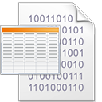

Document contents
Anything that represents incoming or outgoing documents
Often a digital file
Fax
MS Word
JPEG
PDF
CSV
Notes:
Document content can be anything that represents incoming or outgoing documents such as a fax image, a Microsoft Word file, a photograph, or a PDF file. A document content source is code that stores and retrieves the document content.

Slide 6


Document metadata
Attributes that describe and classify a document
Name, Description, Section
Document Type (MIME type)
Related objects, Author, Recipient
Inbound, Status, Security Type, Type, Hidden
Notes:
The base application defines metadata with many attributes, but there is no significant functionality tied to these attributes. Metadata attributes can be configured.
The MIME type determines the application to view and/or edit a document. For example, Adobe Acrobat is the MIME type for PDF files and MS Word is the MIME type for Word files.

Slide 7

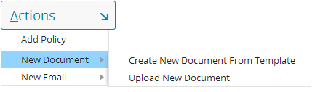

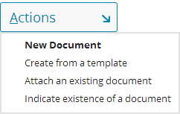

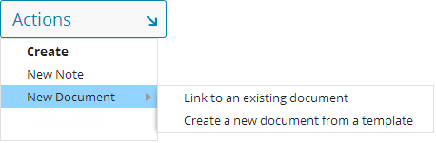
Creating new documents
BillingCenter
ClaimCenter
PolicyCenter
Notes:
In BillingCenter, ClaimCenter, and PolicyCenter, there are menu actions that allow users to create, link, attach, indicate, or upload a document.

Slide 8

Digital document production
Dear <Insured.FullName>,
On <effectiveDate>, your policy…
Document template
Digital document
Dear Ray Newton,
On June 4, 2014, your policy…
Account: C000143542 Policy: 7561197102 Insured: Ray Newton Effective: 06/04/14
Business object data
Document production creates digital documents using a digital template and set of business object data values
Notes:
A document template is a Guidewire template used to generate commonly needed documents. Document templates often include information drawn from the primary business object (claim, policy, account, or producer) and its related records.
A document template can retrieve any information available to the primary business object. In this regard, a document template differs in the various Guidewire applications.
In ClaimCenter, a document template contains information about the claim such as the claim file number.
In PolicyCenter, a document template contains information about the policy such as the deductible for a given coverage.
In BillingCenter, a document template contains information about the account such as the amount due for a policy.
A digital document that results from the document production is often a draft document. The user producing the document often need the opportunity to review, edit, amend, and then finalize the document before it is sent to the relevant party.
Document metadata is stored apart from the document itself.

Slide 9

Five systems for document storage
User System
Guidewire App
Various types of documents can exist in five systems in a Guidewire document management architecture
Doc Production
Doc Storage
Physical Storage
Notes:
There are five systems where information about documents can exist:
The user system
The Guidewire application
A document production system, which stores templates used to generate documents
A document storage system, which stores digital documents
A physical location, which stores physical documents (used in ClaimCenter only)

Slide 10
Physical Documents (ClaimCenter only)
User System
ClaimCenter
Physical Storage
Physical location contains the document itself
For physical documents, ClaimCenter tracks only the information about the document
User can view the information that ClaimCenter has stored about the document, but not the document itself

Slide 11
Digital document storage
User System
Guidewire App
Document Storage
local
master
Guidewire application and document storage system both store (and synchronize) document metadata
Document storage system stores master copy of document
User system views and edits a local copy of the master document
Notes:
Document metadata consists of the type of document, the security permissions for the document, and many other properties and attributes that describe the document. Other properties include, but are not limited to the date created, data modified, the authors, the editors, content tags, document categories, document title, and comments. For some types of photograph and digital image documents, other properties may include the device taking the picture as well as global position system (GPS) coordinates for where the picture was taken.

Slide 12
Digital document production (1)
User System
Guidewire App
Doc Production
Guidewire application sends object data and a template identifier to the document production system
Document production system stores the document template
Document production system creates document and makes the document visible to user system
Notes:
Various digital document production configurations are possible.
Client-side document production consists of the creation of documents on the user system using local application such as Microsoft Word or Adobe Acrobat. Server-side document production consists of an application server creating new documents from a server document template. A server document template can be a physical file or can be an application library that logically represent a document template.
In some cases, document templates are stored on a separate document in the production system. When a document needs to be produced, the business object data values and a document template identifier (name, ID, or GUID) are passed to the document production system. The document production system process the object data using the document template and create a document. The document is available to the user system.

Slide 13
Digital document production (2)
User System
Guidewire App
Guidewire application stores a document template
Guidewire application creates a document with object data
Document visible to the user system
Notes:
In some cases, document templates are stored on the application server that hosts the Guidewire application. The Guidewire application merges the document itself and makes the resulting draft available to the user system. This approach may be less typical for documents authored in a Microsoft product like Word and may be more typical for open-source formats such as PDF.

Slide 14
Digital document production (3)
User System
Guidewire App
Guidewire application stores the document template
Guidewire application sends a document template and object data to the user system
User system creates document
Notes:
In some cases, document production takes places on the user system. In this case, the template and the field values are passed to the user system. The user system's local copy of the application merges the information and creates the document draft.
The three approaches are not mutually exclusive. It is possible for some documents to be produced on a document production system, some to be produced by the Guidewire application server, and some to be produced on the user system. In these circumstances, it is often the type of document that determines where the document is created. For example, in ClaimCenter, a reservation of rights letter may exist in a legacy content management system and be produced on a separate machine whereas a basic, contact the claimant letter is drafted on the user system.

Slide 15
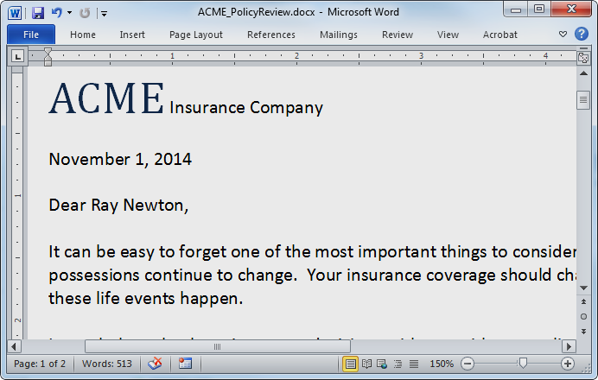
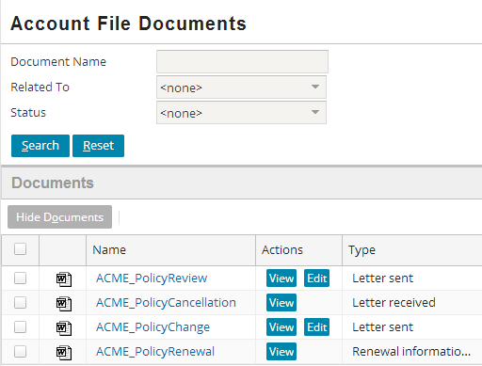
View and editing documents: PolicyCenter
Actions → Documents
Search
View and edit documents

Slide 16
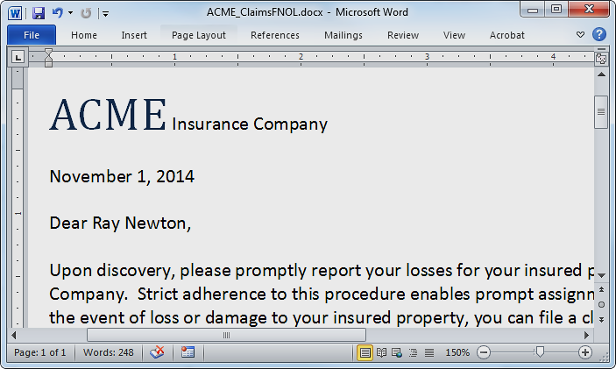
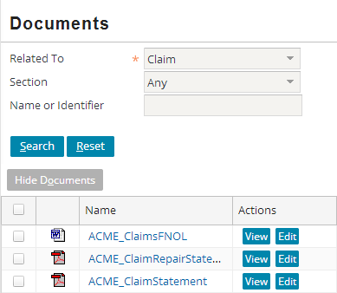
View and editing documents: ClaimCenter
Actions → Documents
Search
View and edit documents

Slide 17
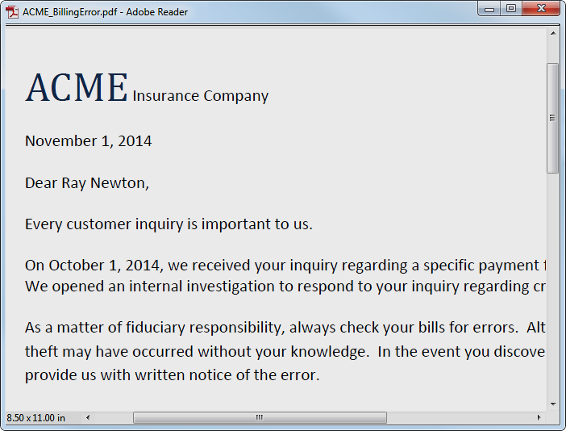
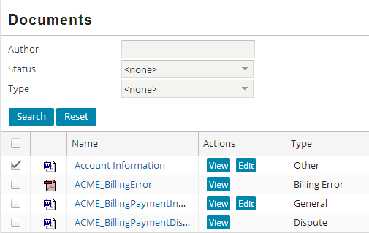
View and editing documents: BillingCenter
Actions → Documents
Search
View and edit documents

Slide 18
Document basics
Document management system (DMS) integration
IDocumentContentSource plugin
IDocumentMetadataSource plugin
DMS integration configurations
Document related SOAP APIs

Slide 19

Document management system (DMS)
Document storage
Document metadata
Date created, Date modified, Author(s)
Editor(s), Tags, Categories, Title, Subject
Document contents (bytes)
Document management
Search and retrieval
Add and update
Indexing
Versioning
Workflow management
Security

Slide 20
Guidewire default DMS implementations
Default DMS implementation
Provided and enabled
xx_document table in Guidewire database stores document metadata
Guidewire application server file system stores document contents
Alternate DMS implementation
Proof of Concept (demo)
Provided, but NOT enabled
User system stores metadata as a serialized Document entity in local file system
Guidewire application server file system stores document contents
Neither implementation intended for production use
Notes:
In the default configuration, asynchronous document storage is enabled. For maximum user interface responsiveness with an external document storage system, choose asynchronous document storage

Slide 21
DMS integration plugins
IDocumentContentSource plugin handles storage and retrieval of document content
Optionally stores metadata
More efficient if same system holds content and metadata
IDocumentMetadataSource plugin manages document metadata and document searches
Optional custom IDocumentMetadataSource plugin
Application stores document metadata in its database
Eliminates runtime dependency on DMS for document metadata and search
Notes:
Guidewire defines two plugins to support DMS integration: IDocumentContentSource and IDocumentMetadataSource plugins.

Slide 22
DMS integration and Document IDs
Document.PublicID
Document.DocUID
Document.Id
Unique identifier for a single document in the DMS
If versioning supported, then PublicID does not change
Unique identifier for a single version of a single document in the DMS
If versioning supported, DocUID most likely changes
Internal Guidewire application property
Not used for DMS
Not used for versioning
Notes:
Depending on how a DMS functions, if the DMS supports versioning, the PublicID property does not change for each new version, but the DocUID property might change.
You can extend the base Document entity to contain version related properties or other properties if it makes sense for your DMS.
Never use the Id property to identify a document. Never get or set this property for document management.

Slide 23
DMS storage choices
No DMS storage
External DMS storage
Use the default implement of the IDocumentContent Source plugin
Do NOT enable IDocumentMetadata Source plugin
To store and retrieve content, implement custom plugin for IDocumentContent Source plugin
If added to DMS outside of a Guidewire application process, implement a custom IDocumentMetadata Source plugin
Notes:
Whichever approach to handling document metadata you choose (internal or external), be aware that you must continue that approach permanently. Note objects and other similar text blocks reference a document within text as a specially-formatted hyperlink within the text itself. The format of this hyperlink within text blocks is slightly different based on whether the Guidewire application or a remote system handles the document metadata. If this quality changes from internal to external, or from external to internal, those document hyperlinks fail.

Slide 24

Internal document storage and metadata
User System
Guidewire App
External systems
1
2
4
3
Notes:
In the slide example, the configuration for document management uses the built-in document content source plugin implementation. The document metadata source plugin remains disabled.
1) Document metadata is stored in Guidewire internal database.
2) Document contents are stored in Guidewire server file system.
3) Integration glue code manages how the Guidewire application and external systems communicate for document management.
4) Optionally, the external system can use web services to link documents to business objects (entities).

Slide 25
External doc storage and internal metadata
User System
Guidewire App
DMS
1
2
5
4
3
Notes:
In the slide example, the configuration for document management uses a custom document content source plugin implementation. The document metadata source plugin remains disabled.
1) The document content source plugin is enabled. The document content source plugin manages how document contents get added, retrieved, and updated.
2) Document content is sent and retrieved from the DMS. The DMS stores document contents.
3) Integration code manages how the Guidewire application and the DMS work together (integration glue code).
4) Optionally, the external DMS can use web services to link documents to business objects (entities).
5) The DMS can retrieve a user system document content from a http URL request.

Slide 26
External DMS with external metadata
User System
Guidewire App
DMS
2
1
3
4
5
6
7
10
9
8
Notes:
In the slide example, the configuration for document management uses a custom document content source plugin implementation and a custom document metadata source plugin.
1) The document metadata source plugin is enabled and manages the document metadata.
2) The document metadata is sent to external system. The DMS stores metadata.
3) The DMS returns metadata including the document unique identifiers (docUIDs).
4) The document content source plugin is enabled and manages the document contents.
5) The document content is sent and retrieved from the DMS. The DMS stores document contents.
6) The document content source plugin optionally manages document metadata.
7) The document content source plugin optionally sets metadata for add and update operations to the DMS.
8) The integration code that manages how the DMS works with the Guidewire application (integration glue code).
9) Optionally, the external DMS can use web services to link documents to business objects (entities).
10) The DMS can retrieve a user system document content from a http URL request.

Slide 27
Document basics
Document management system (DMS) integration
IDocumentContentSource plugin
IDocumentMetadataSource plugin
DMS integration configurations
Document related SOAP APIs

Slide 28
Basic document storage Flow
IDocumentContentSource
Doc Production
Document contents storage
Guidewire App
Modified metadata
(with doc ID)
Newly created or updated document contents
Doc Storage (file sys)
Document metadata storage (if IDocumentContentSource not handling metadata)
IDocumentMetadataSource

Slide 29
IDocumentContentSource plugin
Primarily handles document content
Optionally stores some document metadata
Never used for documents without content
Inferred or Indicated use case
An option only in ClaimCenter
Document retrieval means producing document content
Retrieving document content bytes
Not metadata
No search capability in plugin
Notes:
A significant concern for the content source plugin is the upload size of document content – this content will usually need to be read from the input stream into memory in some fashion, which can potentially cause the JVM to run out of memory.
In config.xml, you can set a parameter to control file upload size:
<!– The maximum allowable file size (in megabytes) which may be uploaded. Any attempt to upload a file larger than this will fail. Since the uploaded document must be handled on the server, this parameter protects the server from possible memory consumption problems. -->
<param name="MaximumFileUploadSize" value="25"/>

Slide 30
Add document
addDocument(InputStream, Document)
Add content (and optionally add / change metadata) on DMS
Set properties on Document entity
DateModified
DMS, true if there is content stored
docUID
publicID if content is identified differently than metadata
persistenceRequired is true
If called with a null InputStream, must deal with metadata in the same way and the above properties should still be set
Return boolean to indicate metadata storage plugin
True = IDocumentContentSource
False = IDocumentMetadataSource
Notes:
The addDocument() method stores new document content in the DMS. The method optionally also can add and/orupdate the metadata contained in the Document entity (xx_document table). Whether or not metadata is modified, the DMS system should synchronize any appropriate mapped data, including its representations of the document identifier such as the DocUID or PublicID, and the DateModified field.
The InputStream will contain the contents to be stored. If there is existing content, set the DocUID or PublicID field (or whatever other fields are being used to uniquely identify the content of the document) to associate the Document entity to its content. If the InputStream parameter is null, and no existing document content can be found, then the behavior is undefined, and will depend on the details of the plugin implementation (most implementations would probably throw an exception). Ideally, the implementation should check to see if there is already content stored for the Document entity as is performed by the isDocument() method.
The IDocumentContentSource implementation may use any fields it wishes to determine where to store the content. It should set the DocUID field, PublicID field, or whatever field(s) are being used to uniquely identify the content corresponding to the Document entity).
The addDocument() method should return true if and only if has stored the document metadata (contained in the Document entity) as well as the contents. Otherwise it should return false, and Guidewire will then call the metadata plugin's saveDocument() method.

Slide 31
Retrieve document
getDocumentContentsInfo(Document, boolean)
Call to retrieve content (boolean is true)
Call to retrieve just metadata (boolean is false)
Uses docUID property to retrieve content from DMS
Uses publicID if content is identified differently than metadata
Any changes to Document entity are not persisted
Returns DocumentContentsInfo object
Encapsulates document contents as an InputStreamCan
Describes Content Response Type
DOCUMENT_CONTENTS, URL, SCRIPT
Specifies MIME type
Notes:
To retrieve the contents of a document, call the getDocumentContentsInfo() method. Use the appropriate field(s) on the Document entity (DocUID or other customer specific fields) to determine the content to return. The Document entity itself should not be modified as any changes made are not guaranteed to be persisted. The boolean argument to include contents should be true if the caller wants the DocumentContentsInfo object to include an InputStream with the contents of the document. If it is false, then the InputStream in the returned DocumentContentsInfo object should be null. The boolean should be false in situations where only the metadata about the document contents (such as the MIME type or the response type of contents to be returned) is required, and the overhead of actually transmitting the document should be avoided. The getDocumentContentsInfo() method returns a DocumentContentsInfo object.
Guidewire may call the addDocument() method with a null InputStream. This can occur as a result of the following scenario:
(1) The user creates a Document entity with some content and clicks Update in the application interface. (2) The document fails validation for some reason. Guidewire has already read the InputStream and uploaded the document. (3) The user fixes the problem and clicks Update again. Any changes made to the document during the previous call to addDocument() method call have been lost. Guidewire calls the addDocument() method again so that the document content source plugin has a chance to set any fields such as the DocUID before the metadata is persisted.

Slide 32
Retrieve document for external use
getDocumentContentsInfoForExternalUse (Document)
Used by EmailMessageTransport
Call to retrieve content description
Appropriate adding document as email attachment
Returns DocumentContentsInfo object
Contains the content
Or, URL reachable by recipients of the email

Slide 33
Document retrieval response types
DocumentContentsInfo.DOCUMENT_CONTENTS
Input stream (bytes) that contains the raw document contents
Enable web viewing of arbitrary input streams such as PDF data
Will be handled by the browser based on its mime-type
Document Assistant (JWS) opens the file in an application
DocumentContentsInfo.SCRIPT
Document contents treated as JavaScript
Will be executed in the browser to display the resulting HTML
DocumentContentsInfo.URL
URL to a local content store to display the content
Permits the highest performance
Will be requested and rendered in the browser
Notes:
The Document Assistant is a signed Java Web Start (JWS) applet requiring Java Runtime Environment 7 (JRE 7) on the client machine. The applet is deployed in the browser by the Java Next-Generation Plugin using the Java Network Launch Protocol (JNLP). The Document Assistant applet is inserted into the browser Document Object Model (DOM) and loaded on demand for the first operation requiring the Document Assistant. The applet and its resources are signed with the Guidewire code signing certificate, and the user is required to accept this certificate at least once. If the user elects to install the Guidewire certificate permanently in their JRE key store, they will never be prompted for authorization again. The user web client must have Java installed. For the list of supported browsers, Java versions, and operating systems, see the Guidewire Platform Support Matrix at https://guidewire.custhelp.com/app/resources/products/platform.
Use DOCUMENT_CONTENTS when the DMS system returns the pure contents of the document. DOCUMENT_CONTENTS is supported in all situations and is the only valid type of response when Gosu create a document. DOCUMENT_CONTENTS is compatible with the Edit/Upload buttons in the base Documents page.
inputStream - Must contain the contents of the document.
responseMimeType - Should contain the mime type of the document
targetHiddenFrame - Not relevant for this content type, may be ignored. Opens content in a hidden frame if true for other content types.
(continued)

Slide 34
Notes:
(continued)
Use the URL type when the DMS integration code will return a URL which, when accessed, will somehow display the document contents. It may be a URL to the contents directly, or to a web page which uses a script or a web control to display the document contents. Use the URL type for when the client, based on physical location, need to be redirected to a local cache of document contents.
inputStream - Must contain the URL
responseMimeType - Not applicable, may be ignored
targetHiddenFrame - Must be true or false depending on whether the URL returned should be opened in a new window or in a hidden frame.
Use the SCRIPT type when the DMS integration code return some JavaScript that the client needs to execute.
inputStream - Must contain the .js file to be executed on the client machine
responseMimeType - For existing document contents, not applicable and may be ignored. For document creation, must contain the mime type of the document which will be created when the jscript executes
targetHiddenFrame - Not applicable, may be ignored

Slide 35
Update document
updateDocument(Document, InputStream)
Update the contents of the document (in InputStream) identified in the Document argument
Optionally also update the metadata in the DMS
Set the DateModified on the Document object
Often increments the document version on the DMS
Return true when performing necessary metadata changes
isDocument(Document)
Check for the existence of content corresponding to this Document entity in the DMS
Often uses docUID or publicID property
Notes:
To update the contents of an existing document in the DMS system, call the updateDocument() method. This is separate from the addDocument() method because the semantics are different, especially regarding name and other unique fields. Whether or not the metadata is stored, the DMS system should update any appropriate data, including version information (if any) and date modified. The InputStream will contain the new contents to be stored in the DMS. The same identifying fields which are set by the addDocument() implementation should be used to determine which content to update. Any versioning is completely up to the implementation. No version information will be set on the Document entity by Guidewire, but the IDocumentContentSource implementation may set version-related fields on the Document entity with the expectation that changes to the Document entity will then be persisted by the application. The updateDocument() method return true when it stores document metadata (xx_dcouments table) and document content changes. When false, Guidewire stores only the metadata.
To determine whether the DMS system contains content corresponding to the docUID or customer-specific field(s) identifying the content, call the isDocument() method to set the field values for the Document entity. The same identifying fields which are set by the addDocument() method or used to locate existing content in the updateDocument() method, should be used to determine whether the content exists corresponding to the Document entity. The isDocument() method implementation returns true when the backing DMS system already contains content corresponding to the appropriate fields on the Document entity, otherwise the method returns false.

Slide 36
Delete document
removeDocument(Document)
Logically or physically delete the content
Optionally delete the metadata
Return true if the necessary metadata changes have been performed
Notes:
To notify the DMS system that the Document entity is about to be removed from metadata storage, call the removeDocument() method. The IDocumentContentSource implementation handles if and how to delete and/or retire the content. Other Document entities may still refer to the same chunk of content. If the removeDocument() method implementation does not take care of the metadata removal as well, then it is possible that some server problem might cause the removal of the metadata to fail even after the removal of the document contents has already taken place.
The same identifying fields which are set by the addDocument() method implementation should be used to determine which content corresponds to this Document entity. The removeDocument() method should return true if it has removed the document metadata from the metadata storage.

Slide 37
Demo implementation
gw.plugin.document.impl. LocalDocumentContentSource
Stores document content in the local file system
…\plugins\document\files\documents
Sub-directory for each root object such as claim
Notes:
In ClaimCenter, see the getSubDirForDocument() method for how the files are created and stored in sub-directories.

Slide 38
Document basics
Document management system (DMS) integration
IDocumentContentSource plugin
IDocumentMetadataSource plugin
DMS integration configurations
Document related SOAP APIs

Slide 39
Basic document search and retrieval Flow
IDocumentMetadataSource
Doc Production
Search criteria
Matching document list
Guidewire App
Metadata (ID) for single document content
Doc Storage (file sys)
Display document contents
IDocumentContentSource

Slide 40
IDocumentMetadataSource plugin
When enabled, handles the document metadata
IDocumentContentSource plugin does not handle metadata in this case
Add / change / remove metadata for documents with content
Always used for documents without content
Supports search
Search may return the metadata
Retrieval means producing metadata

Slide 41
Search
searchDocuments(DocumentSearchCriteria, RemotableSearchResultSpec)
Search DMS for documents matching metadata in DocumentSearchCriteria
RemotableSearchResultSpec enables paging and sorting through the result list
Returns a DocumentSearchResult that contains a Document[] collection
For each item in DocumentSearchResult, set properties as needed
docUID to the linked identifier in the external system
DocumentIdentifier
DMS (true/false)
Notes:
Usually called to populate a list of documents, such as the documents list view panel, the searchDocuments() method retrieves the set of documents which match the given search criteria. The DocumentSearchCriteria values indicate the set of documents that should be returned. The RemotableSearchResultSpec is an object which contains sorting and paging information for the search so that the results can be manipulated by the list view. The DocumentSearchResult object encapsulates a set of Document objects containing information about the documents matching the search criteria. Since the results will be displayed in a list, the Document objects returned need not be fully populated. The objects must have all properties set which will be used in the lists and any properties which would be required to retrieve the contents or a detail view of the document.

Slide 42
Other methods
retrieveDocument(docUID)
Retrieve the metadata for the document with the given identifier
Set the docUID of the returned document to the ID that was retrieved
Set DMS and/or DocumentIdentifier properties
saveDocument(Document)
Create or update the metadata for a Document
removeDocument(Document)
Logically or physically delete document metadata
Notes:
To display the complete metadata for a document, call the retrieveDocument() method. The retrieveDocument() method retrieves the complete metadata for a single document. The returned document should be completely populated. The docUID value of the Document entity being retrieved is a unique and is set as the value of the Document entity’s docUID property. It uniquely identifies the document on the external DMS to return the appropriate metadata.
To persist either a new Document’s metadata or changes made to the metadata for an existing Document, call the saveDocument() method after the IDocumentContentSource interface has persisted the document contents. This is not necessary, however, if the IDocumentContentSource interface handles metadata persistence itself and returns true. The saveDocument() method is also called in the case of saving metadata changes to an inferred document (null document reference). The Document parameter represents the new set of metadata to be saved to the backing DMS system.
When the user indicates that a Document should be permanently removed from the Guidewire application, call the removeDocument() method. If the document metadata stored in the DMS is referenced from multiple objects (like Claims) in the Guidewire application, it is up to the DMS system to do whatever reference counting or other mechanism is required to remove the Document from one context but not another. The Document parameter represents the document to be removed.

Slide 43
Other methods(Content and Metadata)
isInboundAvailable()
isOutboundAvailable()
If the external DMS is available for the desired actions
Inbound content methods
addDocument()
updateDocument()
removeDocument()
Inbound metadata methods
saveDocument()
removeDocument()
Outbound content methods
isDocument()
getDocumentContentsInfo()
Outbound metadata methods
searchDocuments()
retrieveDocument()

Slide 44
Demo implementation
gw.plugin.document.impl. LocalDocumentMetadataSource
Stores document metadata in xx_document (Document entity)
Proof of Concept (POC) implementation
Serializing document metadata to directory
…\plugins\document\files\metadata

Slide 45
Document basics
Document management system (DMS) integration
IDocumentContentSource plugin
IDocumentMetadataSource plugin
DMS integration configurations
Document related SOAP APIs

Slide 46
DMS integration considerations
Is the DMS availability at 99.9% to build document lists?
Is the DMS able to handle modifying both content and metadata in a single call?
Is external and Guidewire data synchronization required?
Notes:
When the IDocumentMetadataSource is configured, the DMS manages the metadata storage. Otherwise the Guidewire application uses the xx_documents table (Document entity) to manage the metadata storage.

Slide 47
First DMS integration option
Custom configuration of IDocumentMetadataSource
Read-only of metadata
IDocumentContentSource
Writes metadata and handles updates
No content documents
Returns true: addDocument(), updateDocument(), removeDocument()
xx_document table is NOT used

Slide 48
First DMS integration option Method call sequences (1)
Create document
1. IDocumentContentSource.addDocument()*
Returns true
List documents
1. IDocumentMetadataSource.searchDocuments()
Retrieve document (contents)
1. IDocumentMetadataSource.retrieveDocument()
Retrieve call may be omitted if search has loaded metadata
2. IDocumentContentSource.getDocumentContentsInfo()
Notes:
The complete set of lifecycle calls is:
New document with content. Can be a template or locate file reference. Calls addDocument() with a non-null input stream.
New document with content fails validation after content is uploaded. User resubmits. Calls addDocument() with null input stream*.
New document with no content. The document is inferred or is indicated. Calls saveDocument().
Edit document with content from a user interface. User can change content only. Calls updateDocument with InputStream.
Edit document with content from a user interface. Edits metadata only. Calls saveDocument().
Edit document with content from a user interface. Change (swap) content only. Calls addDocument() with input stream.
Edit document with content from a user interface. Change content and metadata. Calls addDocument() with input stream. Unless a retry of failed update, then no stream*.
Edit document with no content from a user interface. Edits only metadata. Calls saveDocument().
The rather unexpected addDocument () calls made from the document detail view panel when "swapping" content illustrates the use case for when the new content does not yet exist on the DMS. An upload of edited content from the user interface might require the DMS to save the document, notate a version change of the edited content, and replace the bytes.
* There can be a null input stream due to the content having already been uploaded. When this occurs, the addDocument() and updateDocument() methods need to make any required metadata changes and not attempt to modify or remove any existing content.

Slide 49
First DMS integration option Method call sequences (2)
Update document content only
1. IDocumentContentSource.updateDocument()
Returns true
Update document metadata only
1. IDocumentMetadataSource.saveDocument()
Delete document
1. IDocumentContentSource.removeDocument()
Returns true
Notes:
Note for the case of swapping document content from the document's detail view panel, the call sequence is :
Update document content and possibly metadata
1. IDocumentContentSource.addDocument()
returns true
If the search that builds the objects in the list view panel has already gathered sufficient metadata, then it is not necessary to call retrieveDocument(). This is the default configuration.

Slide 50
First DMS integration option Runtime characteristics
Create, update and delete operations may be more efficient
IDocumentContentSource deals with contents and metadata
A second remote call is avoided
Appropriate for a single DMS that…
Maintains content and metadata
Can modify content and metadata with API in one call
List documents depends on DMS availability
IDocumentMetadataSource accesses the DMS
searchDocuments() synchronizes during every read

Slide 51
Second DMS integration option
Custom configuration of IDocumentMetadataSource
Read and write of metadata
IDocumentContentSource
Returns false: addDocument(), updateDocument(), removeDocument()
xx_document table is NOT used

Slide 52
Second DMS integration option Method call sequences (1)
Create document
1. IDocumentContentSource.addDocument()
Returns false
2. IDocumentMetadataSource.saveDocument()
List documents
1. IDocumentMetadataSource.searchDocuments()
Retrieve document
1. IDocumentMetadataSource.retrieveDocument()
Retrieve call may be omitted if search has loaded metadata
2. IDocumentContentSource.getDocumentContentsInfo()

Slide 53
Second DMS integration option Method call sequences (2)
Update document
1. IDocumentContentSource.updateDocument()
Returns false
2. IDocumentMetadataSource.saveDocument()
Delete document
1. IDocumentContentSource.removeDocument()
Returns false
2. IDocumentMetadataSource.removeDocument()

Slide 54
Second DMS integration option Runtime characteristics
Create, update and delete operations may be less efficient
Calls both IDocumentContentSource and IDocumentMetadataSource
Appropriate for different DMS’s that…
Maintain content versus metadata
Have no API allowing for content and metadata to be modified in one call
List documents depends on DMS availability
searchDocuments() synchronizes during every read

Slide 55
Third DMS integration option
Base configuration of IDocumentMetadataSource
IDocumentContentSource
Returns false: addDocument(), updateDocument(), removeDocument()
xx_document table for read / write of metadata
May redundantly store document metadata in the DMS

Slide 56
Third DMS integration option Method call sequences (1)
Create document
1. IDocumentContentSource.addDocument()
Returns false
2. Row added to xx_document table
List documents
1. Query of xx_document table

Slide 57
Third DMS integration option Method call sequences (2)
Retrieve document
1. Reads row from xx_document table
Read may be omitted if search has loaded metadata
2. IDocumentContentSource.getDocumentContentsInfo()
Update document
1. IDocumentContentSource.updateDocument()
Returns false
2. xx_document table row updated
Delete document
1. IDocumentContentSource.removeDocument()
Returns false
2. Row marked as retired in xx_document table

Slide 58
Third DMS integration option Runtime characteristics
Create, update and delete operations may be more efficient
No remote call through IDocumentMetadataSource
Guidewire application queries its database for document list
List documents independent of DMS
DMS metadata changes are not detected
Synchronization issues between Guidewire xx_document table and DMS possible

Slide 59
Third DMS integration option Variant
IDocumentContentSource modifies DMS metadata
Returns false
DMS stores metadata in parallel to xx_document
Metadata versions must be synchronized
Concern if metadata on DMS is changed outside of Guidewire
Is not synchronized upon searchDocuments()
Listing documents is still independent of the DMS
Read metadata from xx_document

Slide 60
Document basics
Document management system (DMS) integration
IDocumentContentSource plugin
IDocumentMetadataSource plugin
DMS integration configurations
Document related SOAP APIs

Slide 61
Document related SOAP APIs
Add document metadata to Guidewire programmatically
APIs that have methods for adding documents:
ClaimAPI (CC)
BCAPI (BC)
AccountAPI (PC)
May be used by external system to notify Guidewire
Sends document ID and other metadata for document added / changed directly on the DMS*
Notes:
*The document related APIs do not differentiate adding Documents from updates. For example, there are only addDocument() or similar methods.
When the document related APIs are used by an external client, the assumption is that the incoming document's content has been handled separately and already exists on the DMS.
In order to match the entity metadata with its content, the corresponding identifier (often the DocUID property) that is used to locate the content on the DMS should be set on the SOAP Document entity.
During an API call to add a document, the document metadata source plugin calls saveDocument() to handle the metadata for the incoming Document entity. The document content source plugin is not called.
If you implement saveDocument() such that an update on an existing document can be differentiated from the addition of an entirely new document, use the incoming document's PublicID or DocUID properties to determine if the document was already saved into Guidewire.

Slide 62
Explain how to integrate a Guidewire application with an external Document Management System (DMS)
Identify the plugins that enable DMS integration
Implement the plugins to support DMS integration
Deploy and configure DMS integration plugins
Describe the features and limitations of Guidewire’s demo or default implementations of document storage functionality

Slide 63
A Guidewire application uses which plugin interfaces for document storage?
Which plugin interface is a required interface?
What are the characteristics of the default implementation for document metadata storage?
What are the characteristics of the default implementation for document content storage?
Name the three (3) types of document contents that a Guidewire application supports.
Notes:
Answers
1) IDocumentMetadataSource and IDocumentContentSource
2) IDocumentContentSource
3) Document metadata is stored in the Guidewire database
4) Document content is stored in the file-system of the Guidewire application server.
5) DOCUMENT_CONTENTs, SCRIPT, URL

